Slide 1

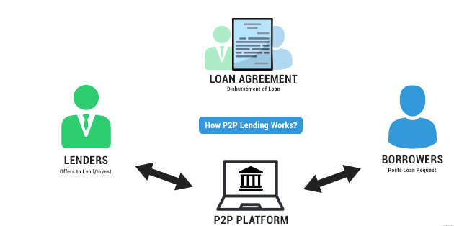
Peer-To-Peer Credit Risk Analysis
Team Details
Team Members
Prakash Kumar Singh
Prasanna Turamari
Zeeshan Ahmed
Sappu Ojha
Gaurav Aher(T.L)
Team Mentor Ms. Anjana Agrawal

Slide 2

Problem Statement
P2P loans are not completely secure as they involve substantial risk of default (credit risk) and hence require an added effort to identify and determine responsible borrower from a pool of unknown users.
Prediction of credit default of an individual, is very powerful risk assessment tool to contribute to save the principal and interest amount.
By understanding and analyzing previous p2p lending records which have either ‘Charged Off’ or ‘Fully-paid’, our main objective is to help predict whether the potential borrower will default or not, based his details.

Slide 3
What are the value additions you planned?
Why it is important problem
It aims to analyze the credit risk involved in peer-to-peer (P2P) lending system of “Lending Club” Company. The P2P system allows investors to get significantly higher return on investment as compared to bank deposit, but it comes with a risk of the loan and interest not being repaid.
We’ll apply descriptive analysis and making predictive model to predict loan status for the borrowers and lenders. Loans taken by the borrowers can be fully paid, default or charged off depend on various factors.
In this project we will primarily deal with few of those predictor and try to make prediction model for loan status.
Suggested solution for the defined problem
By understanding and analyzing previous p2p lending records which have either ‘Charged Off’ or ‘Fully-paid’, our main objective is to help predict whether the potential borrower will default or not, based his details

Slide 4
Data sets considered
Data is taken from Kaggle (Lending Club Dataset)
No. of features: 27
No. of records: 396030
Target Column: loan_status
Redundant columns: sub_grade, emp_title, title are dropped.

Slide 5
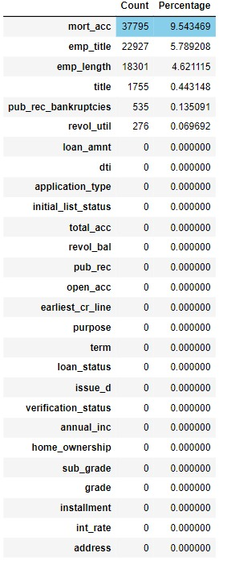
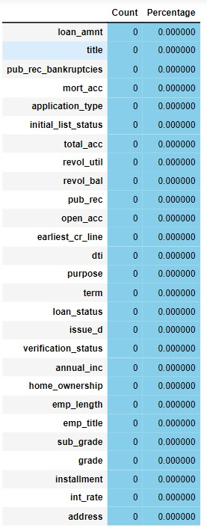
Data Explanatory Analysis
Before
Treating Null Values
After
we found that for most of the `NaN` Values of 'title' in the 'application type' column is `individual(94.87%)`, so in our further checks we consider application type `Individual` and check the corresponding values against individual in the title column and found it to be 'Debt consolidation' .Thus, we impute the null values of the title column with 'Debt consolidation'

Slide 6
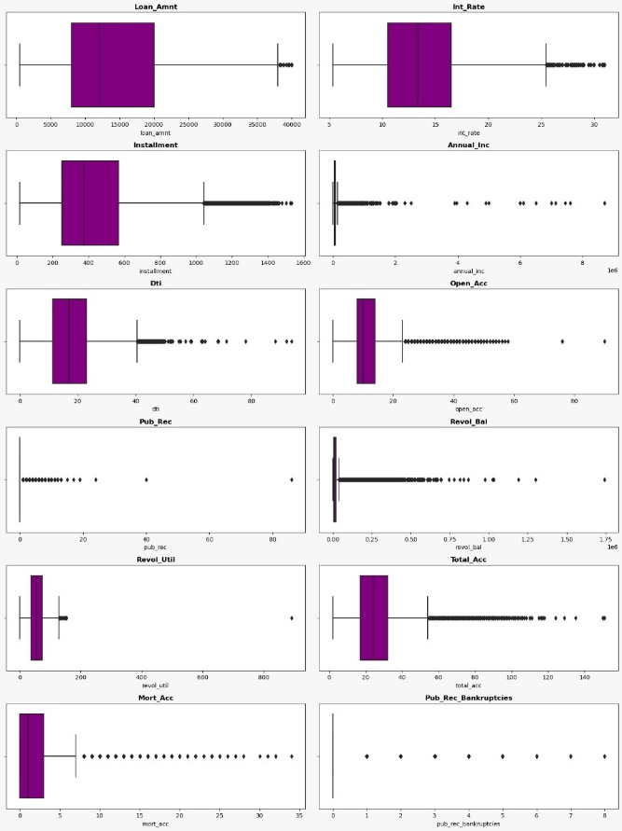
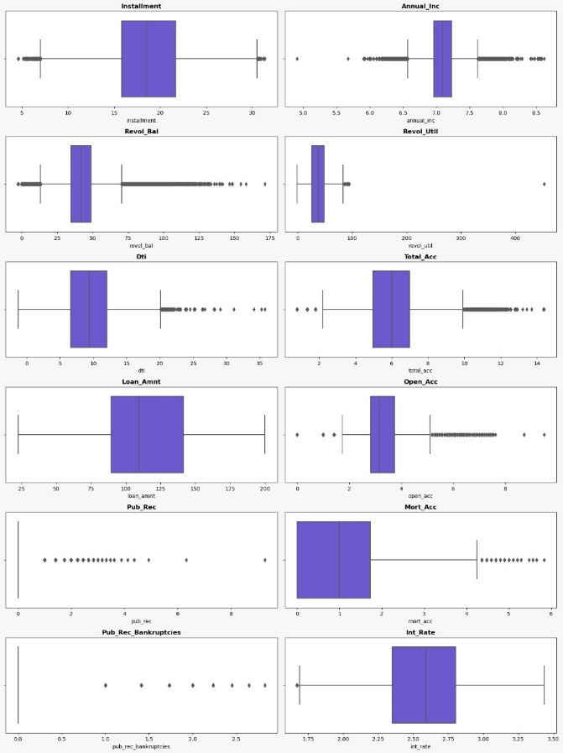
Dealing with Extreme values
Before
After
• Multiple Extreme values detected in numerical features using box plot • Same was taken care of by using Box-cox transformation, Log transformation & Square-root transformation. • Observed using box plot, not all Extreme values are removed. • But we managed to get them reduced to significant extent.

Slide 7
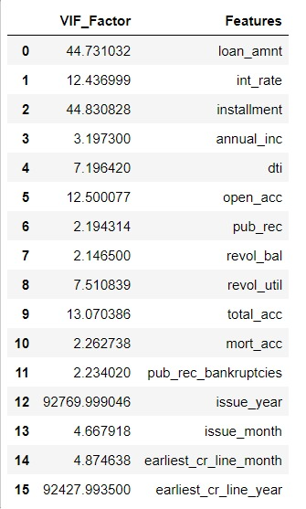
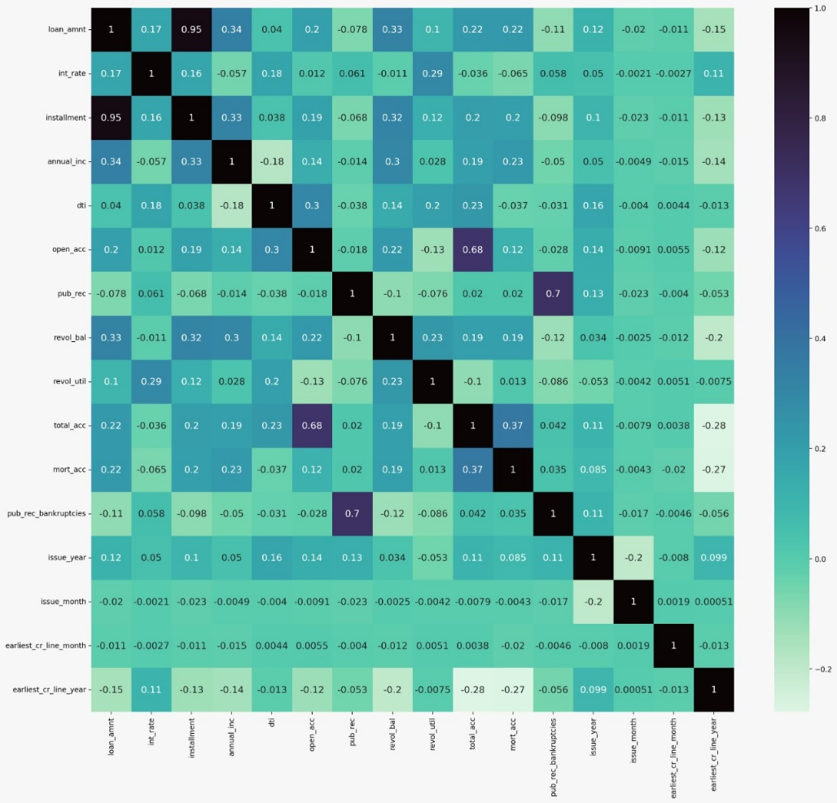
Relationship between variables
Features involved in multicollinearity are loan_amt , int_rate, installment, open_acc, total_acc, issue_year, earliest_cr_line_year. We can treat this features by using PCA transform or we can drop it based upon model need.
Treating Multi- Collinearity by using The Variance Inflation Factor (VIF) The value of VIF equal to 1 indicates that no features are correlated. We calculate VIF of the numerical independent variables.

Slide 8
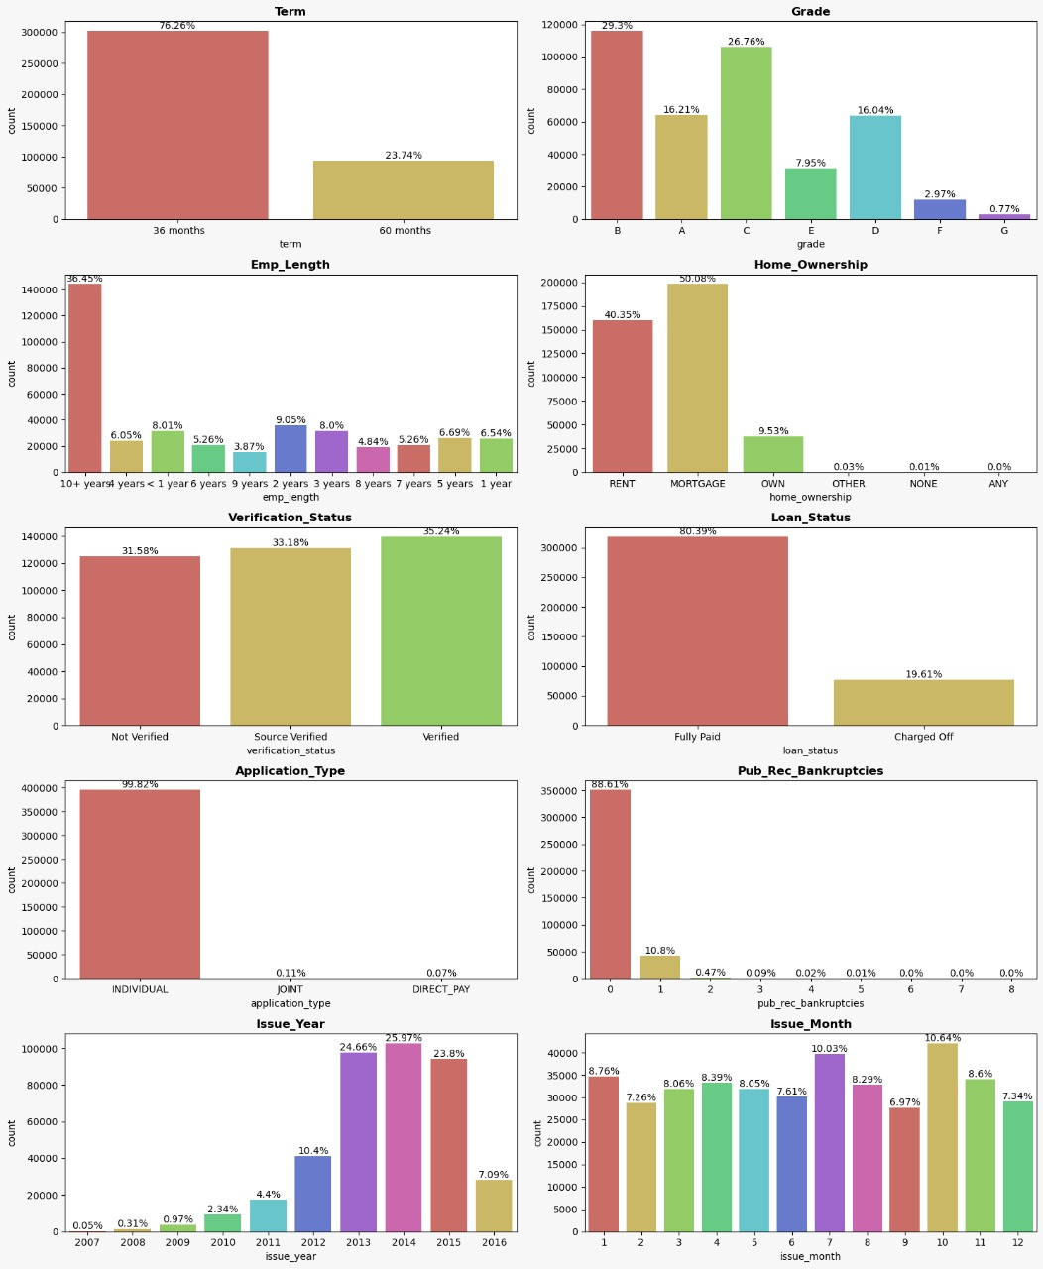
Univariate Analysis
INSIGHTS:
Most of the borrower`(76.26%)` have chosen `36 month` term for their loan repayment, only `23.74%` borrower choose for `60 month` term for their loan repayment
`29.3% `loan disbursed in *B* grade category(Interest rate category), followed by *C* grade `26.76%` and so on.
For Most of the borrower employment length is `10+ Year(36.45%)`, that means most of the loan given to the person whose employment length `10+ year` then followed by employment length `2yaers(9.05%)` and so on.
`50.08%` Borrowers in their loan application about the home ownership shows that they have already a loan running on their house(`Mortgage`)., then followed by Borrowers(`40.35%`) who live in a rented house. very few borrowers(`9.53%`) shown in their application that they own a house.
`35.24%` Borrower's income are Lending club Verified followed by Source Verified(`33.18%`) and then not verified(`31.58%`).
`99.82%` borrowers applied for the loan as individual, i.e., no co-borrowers , only `0.11%` applied jointly(with two co-borrowers) for the loan.
`88.61%` Borrowers have 0 record of public Bankruptcies, followed by 1 time record(`10.08%`) public record bankruptcies and so on.
Most of the Loan(`25.97%`) Issued in 2014, followed by `24.66%` in 2013 ,`23.8%` in 2015 and so on.
Most of the Loan(`10.64%`) Issued in October, followed by `10.03%` in July ,`8.76%` in January and so on.
10. `80.39%` Borrowers have fully paid their Loan, and `19.61%` Borrowers have defaulted from their Loan.

Slide 9
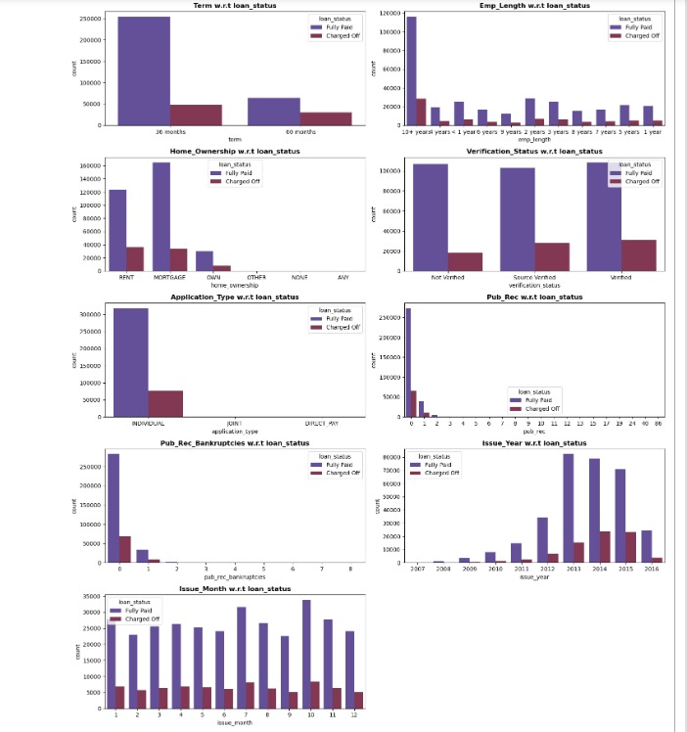
Bivariate Analysis
INFERENCE:
Most of the Borrowers who choose for `60 month` term for their loan repayment have fully paid their loan, also the *no of defaulters* are less compared to the borrowers who choose `36 month` term for their loan repayment.
Borrowers with `emp length >10 years` have fully paid their Loan, and also the number of defaulters compare to other emp_length is more in this category. emp_length with `9 years` have less number of defaulters compare to others.
Borrowers who shows their homeownership as mortgage(loan running on house) has mostly fully paid the loans compare to others rent and owned house, borrowers with rented house has more no of defaulters and borrowers with own house has less no of defaulters.
pub rec of bankruptcies has no such effect on loan status.

Slide 10
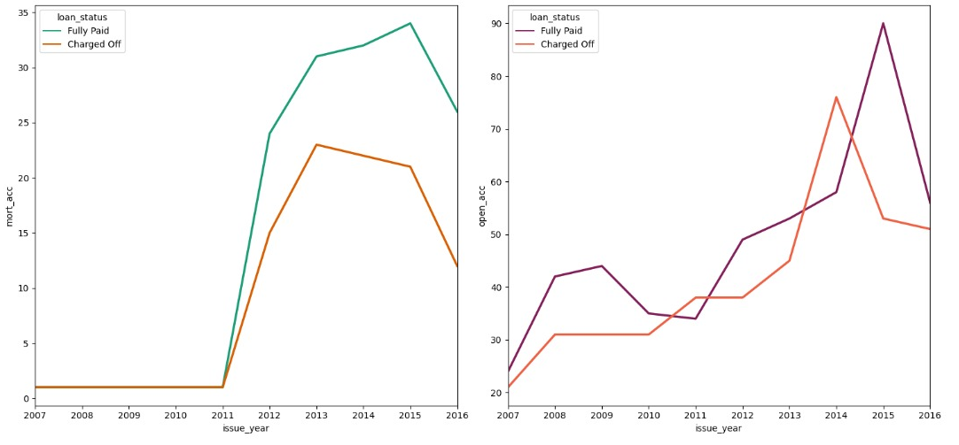
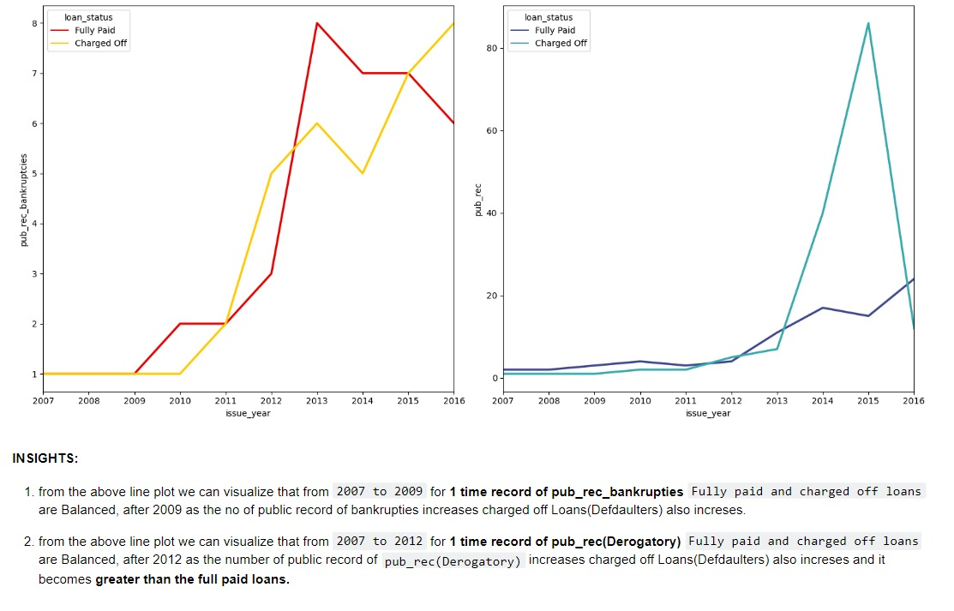
Multi-Variate Analysis
INSIGHTS:
we can visualize that From `2007 to 2011` for `one mortgage_account`, *fully_paid loan* and *charged off loan(Defaulters)* are balanced, after 2011 as the number of mortgage account increases the number of `charged off loan(Defaulters)` also increases.
we can visualize that as the no of `open accounts(open credit lines)` by the year increases `charged off loan` also increases, and also at some point *(2011 ,2014)*, its was more than the `fully paid Loans`
INSIGHTS:
from the above line plot we can visualize that from `2007 to 2009` for *1 time record of pub_rec_bankrupties* `Fully paid and charged off loans` are Balanced, after 2009 as the no of public record of bankruptcies increases charged off Loans(Defaulters) also increases.
from the above line plot we can visualize that from `2007 to 2012` for *1 time record of pub_rec(Derogatory)* `Fully paid and charged off loans` are Balanced, after 2012 as the number of public record of `pub_rec(Derogatory)` increases charged off Loans(Defaulters) also increases and it becomes *greater than the full paid loans.

Slide 11
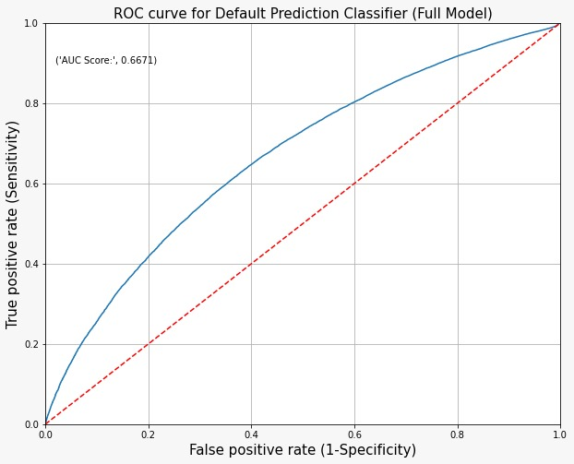
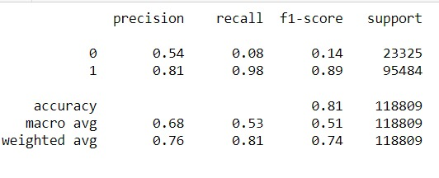
Base model
Logistic Regression Classification
ROC-AUC curve (Score)
where 0 represents charged off and 1 represents fully paid.
Accuracy score for the base model is 81 percent
Roc-Auc Score for the base model is 0.6671.
NOTE: Before building Base model We have done statistical analysis for both Numerical and categorical variable.
Future Work
We are going to use decision tree and random forest classifier to build the best possible model. we will use Gini, entropy combination to use the best possible information gain.
We will also use KNN and naive bayes model.
We are going to use grid search cv in order to find the optimal value of hyperparameter to increase model efficiency.
We will be using several feature selection algorithm like backward selection, forward selection and RFE to find the best possible feature for the model.
We will use several Boosting Techniques like AdaBoost , Gradient Boosting And XGBoost to increase the performance of the model.
Assumptions:
linearity in the logit for continuous variables absence of multicollinearity lack of strongly influential outliers

Slide 12
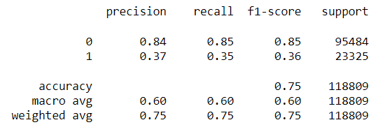
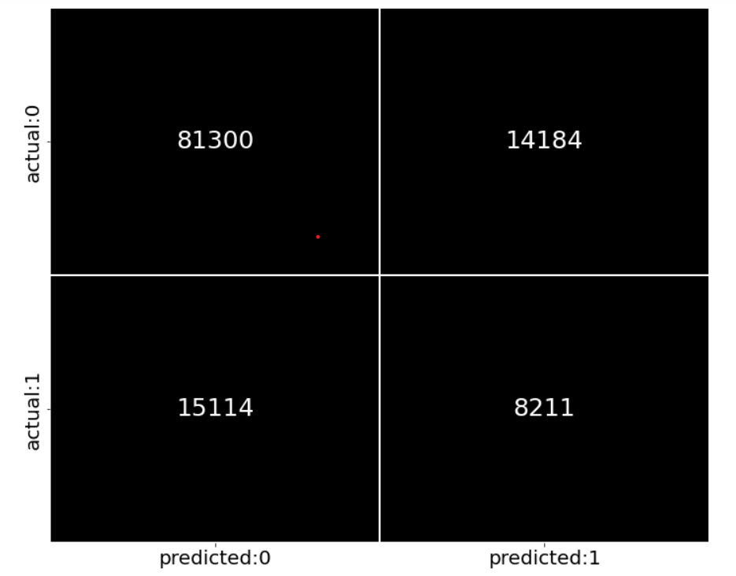
Using Smote for oversampling

Slide 13
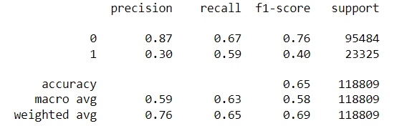
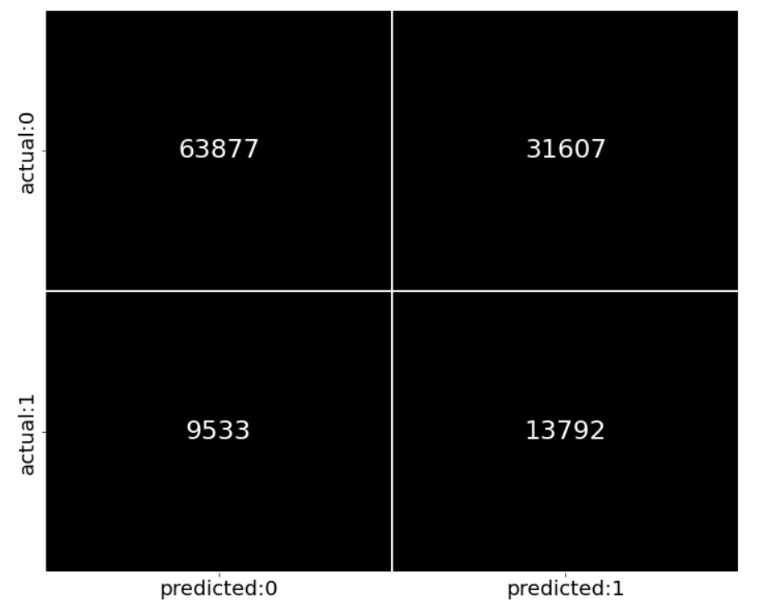
Oversampling using minority sampling strategy

Slide 14
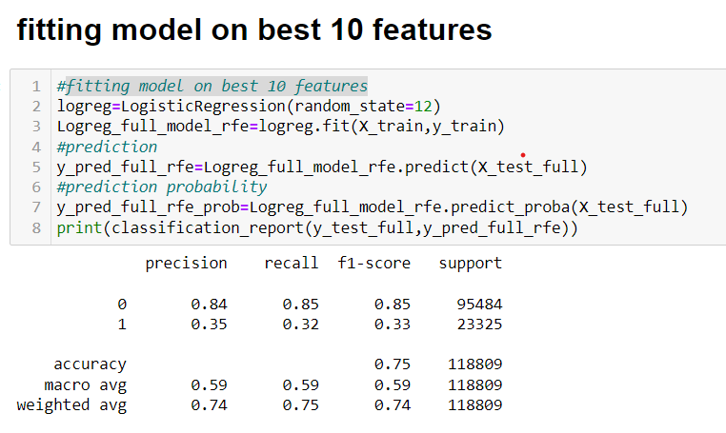
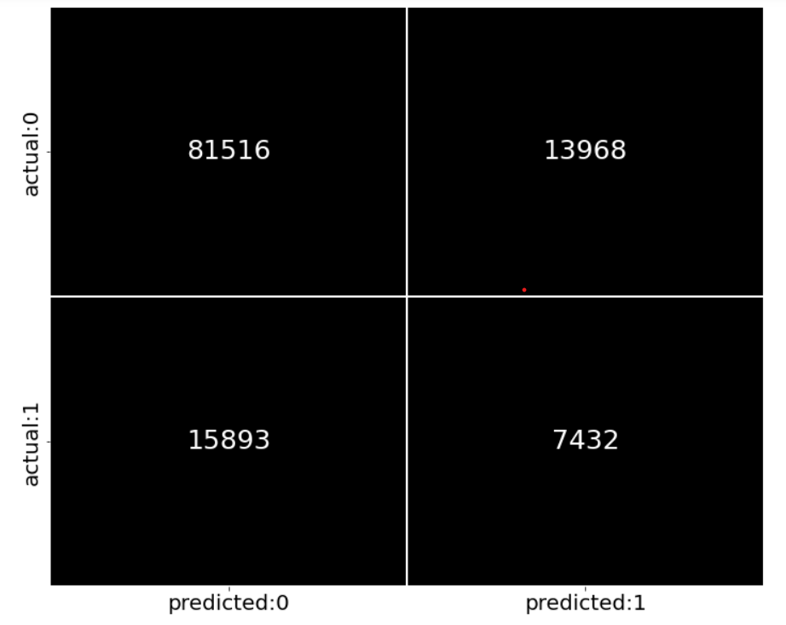
Fitting model on best 10 Features

Slide 15
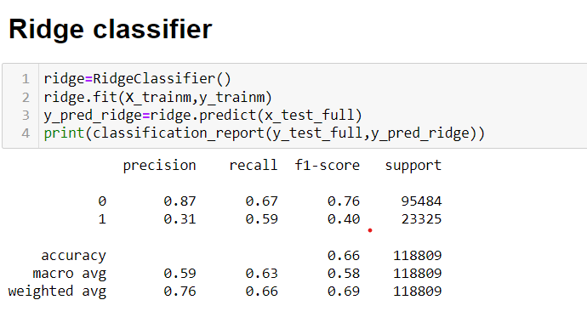
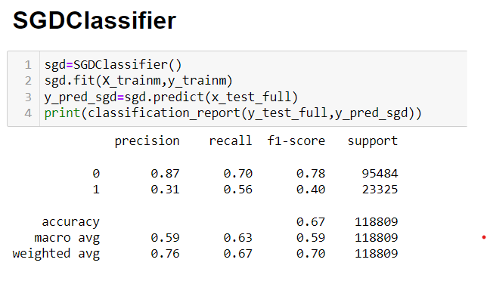
Inference:
Here we can see that FN has been reduced at a certain level when we used smote oversampling using minority strategy.

Slide 16
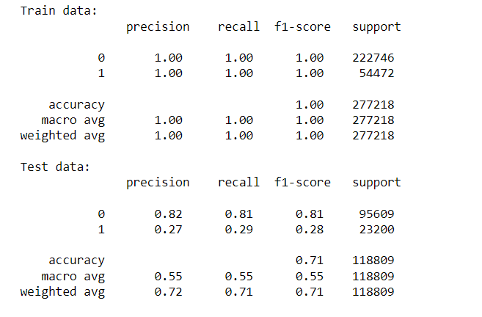
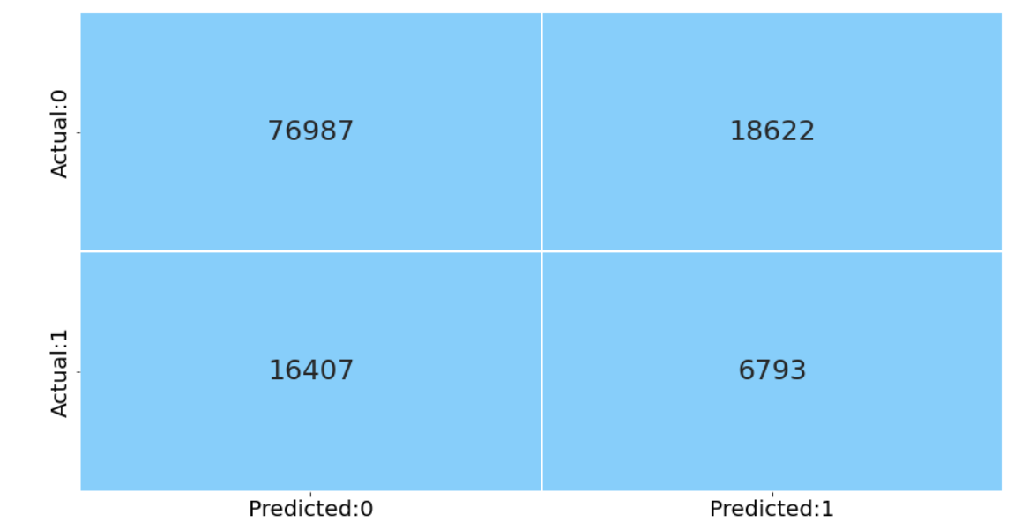
Decision Tree Model
The over fitted model has the test accuracy of 71%
Since the data has imbalance target variable(20:70) so accuracy is not trustable.
The positive class is that the person has not paid the debt.

Slide 17
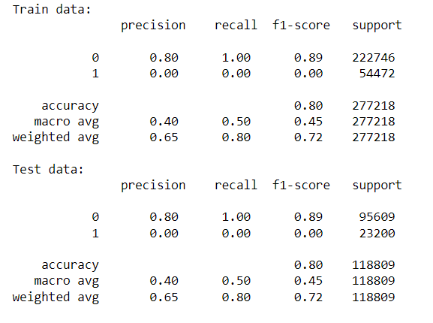
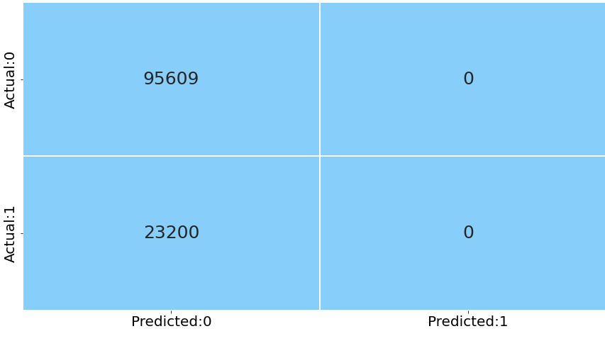
Decision tree with hyperparaeter Tuning
The pruning was done by tuning the hyper parameters and the parameters are as followes.
Best parameters for decision tree classifier: {'criterion': 'entropy', 'max_depth': 5, 'max_features': 'sqrt', 'max_leaf_nodes': 2, 'min_samples_split': 4} .
The accuracy does increases but the model loses the ability to predict the people who are defaulters.

Slide 18
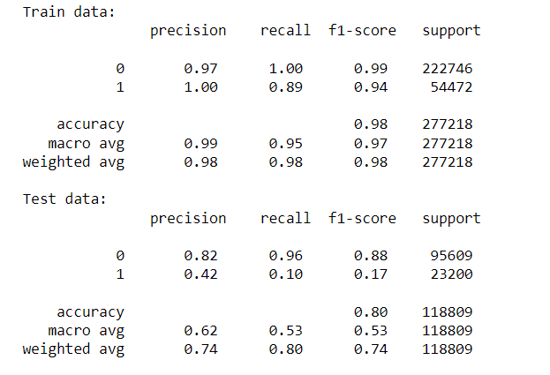
Random Forest Classifier
This is a model with over fit.
It does not improve much from the decision tree model

Slide 19
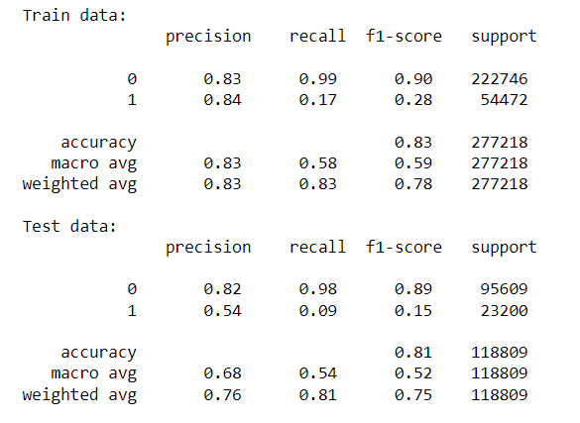
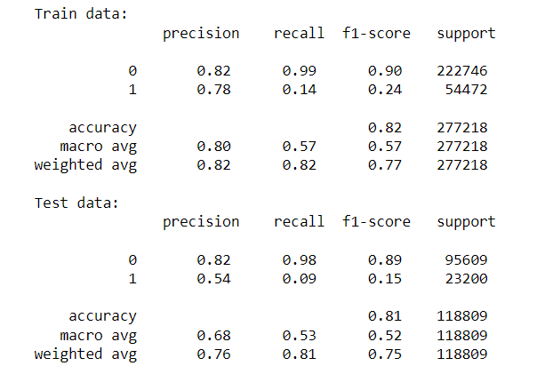
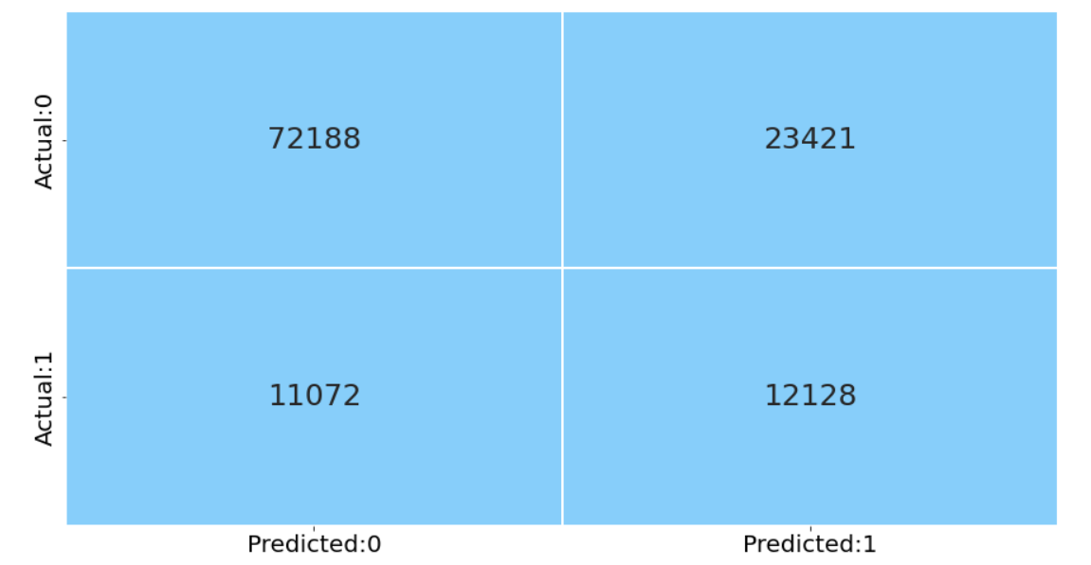
Boosting Models
XG Boost
Gradian Models
Boosting Scores:

Slide 20
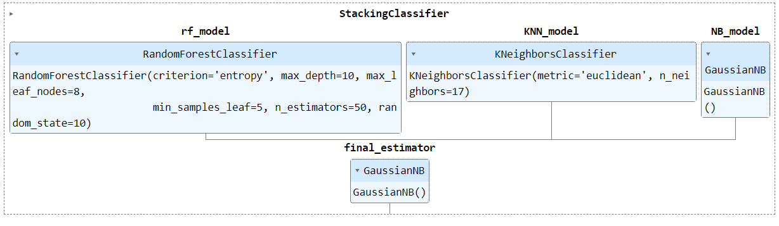
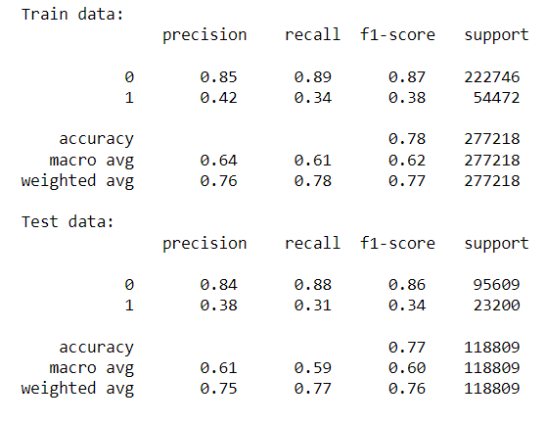
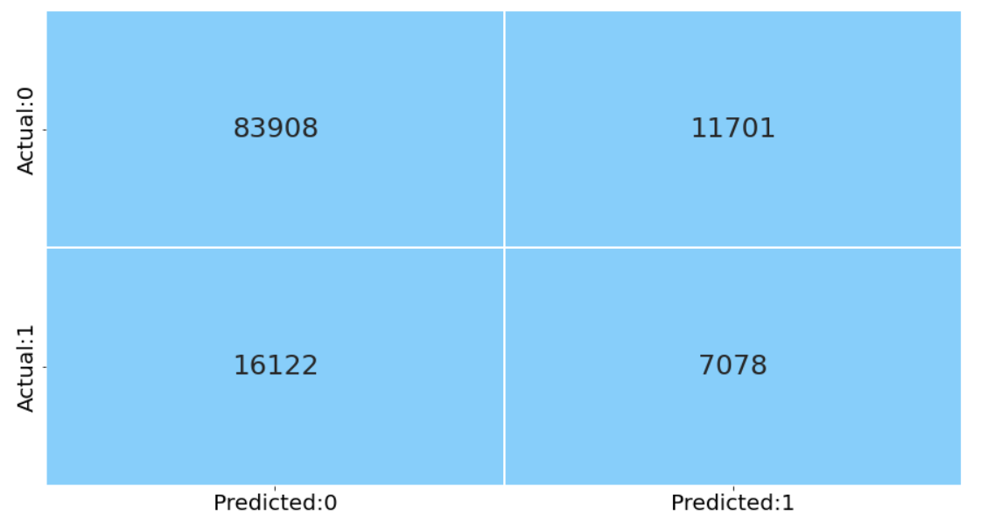
Stack model(randomforest,knn,baysmodel)

Slide 21
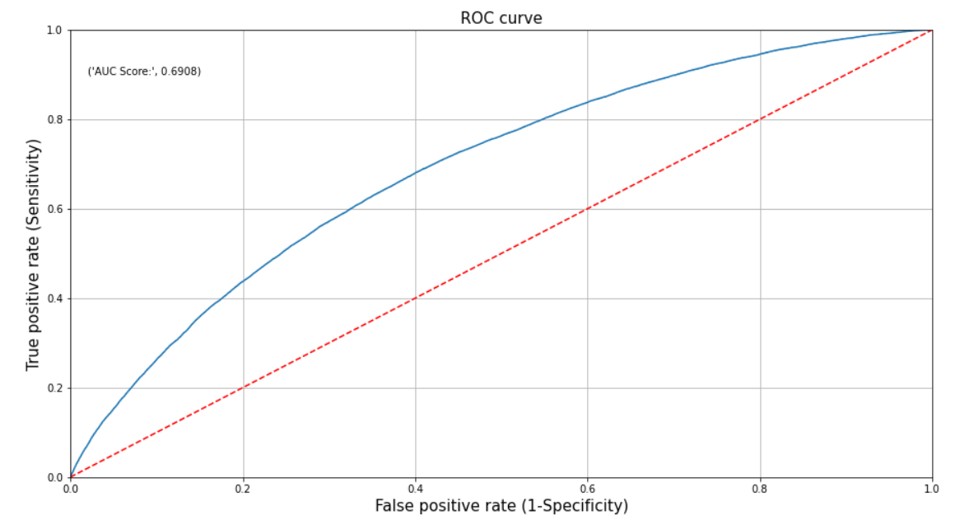

Slide 22
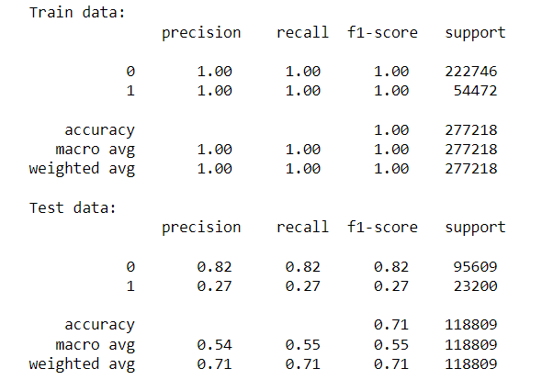
Over Sampling
Decision Tree
Inference:
Here we can see that FN has been reduced at a certain level when we used smote oversampling using minority strategy.

Slide 23
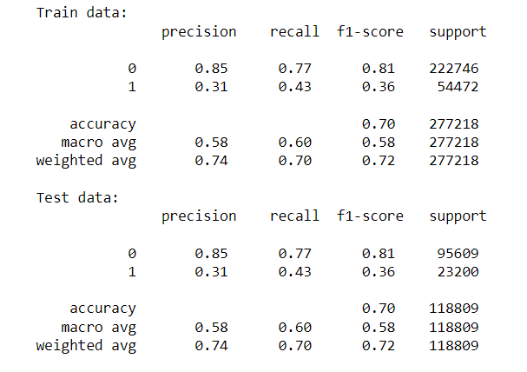
Decision tree resampled after parameter tunning
Inference: -
The train and test Accuracy are comparable, which shows the reduction in overfitting.
In this case the false negative and false positive values can be trusted and the FN value are quite High, but as our focus is on reduction of False negative values
Typically, Random Forest classifier is more accurate than a single decision tree, we rebuild the model using the same to reduce the FN and increase the accuracy

Slide 24
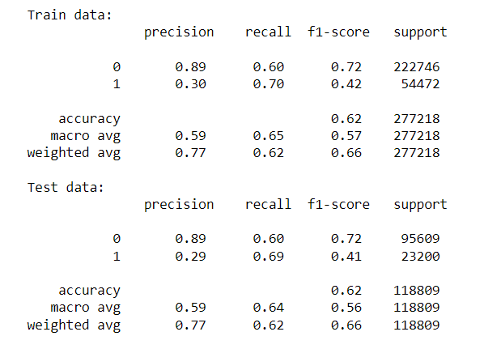
Random forest
Inferences:
From The above model, our train accuracy is 0.98 and test accuracy is 0.80, result is Overfitting
As the model is over fitted, our false Negative and false Positive is inaccurate

Slide 25
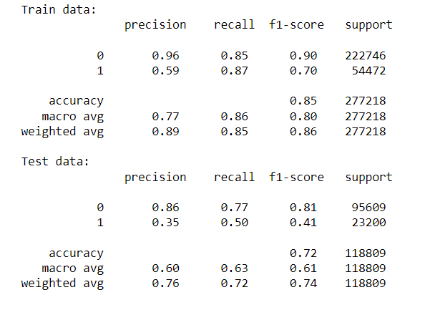
Gradient boosting

Slide 26
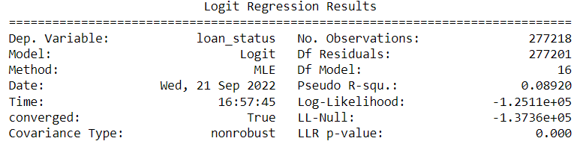

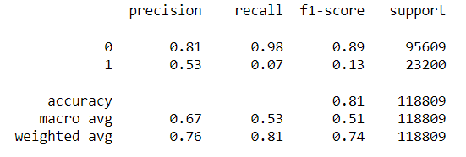
Logistic regression on PCA

Slide 27
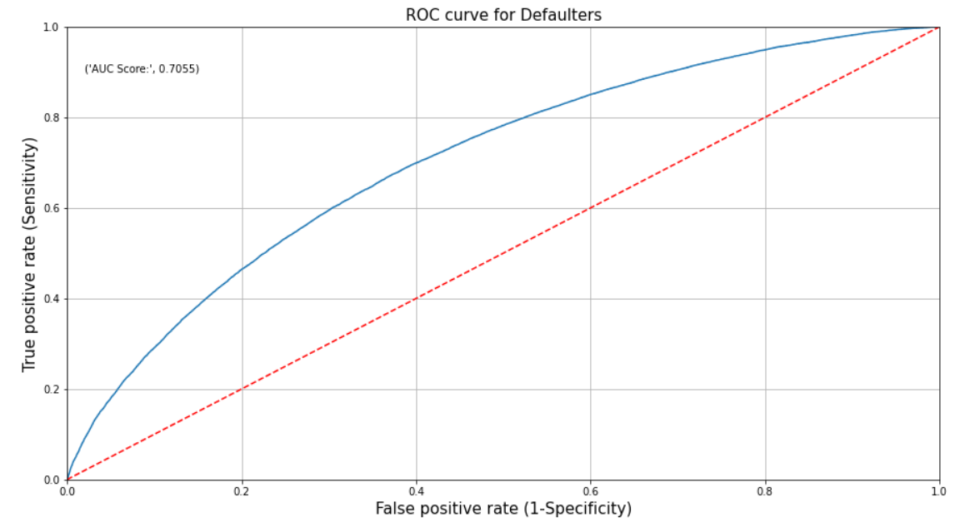
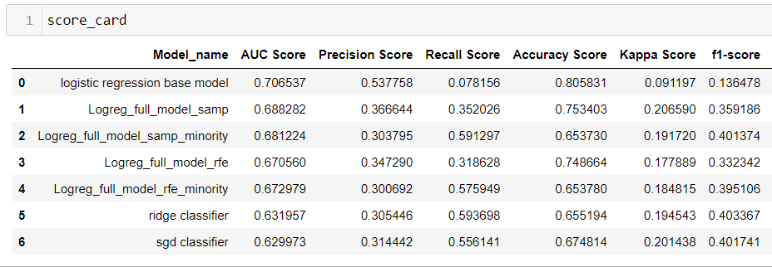

Slide 28
INTERPRETATION:
if we compare all these models then the Logreg_full_model_samp_minority can be considered as a good model because all the model parameters like accuracy, Kappa score,'f1-score is high for this model and also precision, and, recall are more balanced for this model. but overall model is not doing great in predicting defaulters.
Conclusion:
Logreg_full_model_samp_minority model performance is good, but it can be improved by passing different values and obtain a cut-off based on the passed values (Youden's Index, Cost-based Method).
Hyperparameter tuning can lead to more optimized model.
We have to implement various classiﬁcation machine learning algorithms and take feedback for them. This will take us to the best suited model

Slide 29
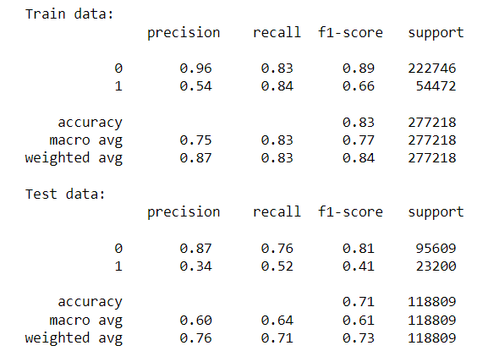
XG BOOST
Inference:
According to XGBoost model report, we can observe that model is overfitted.
Compared to previous models, the FN has reduced.
Lets build another XGBoost model using RFE

Slide 30
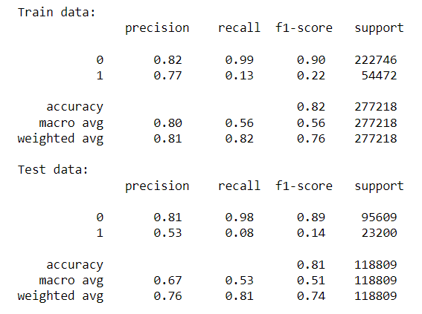
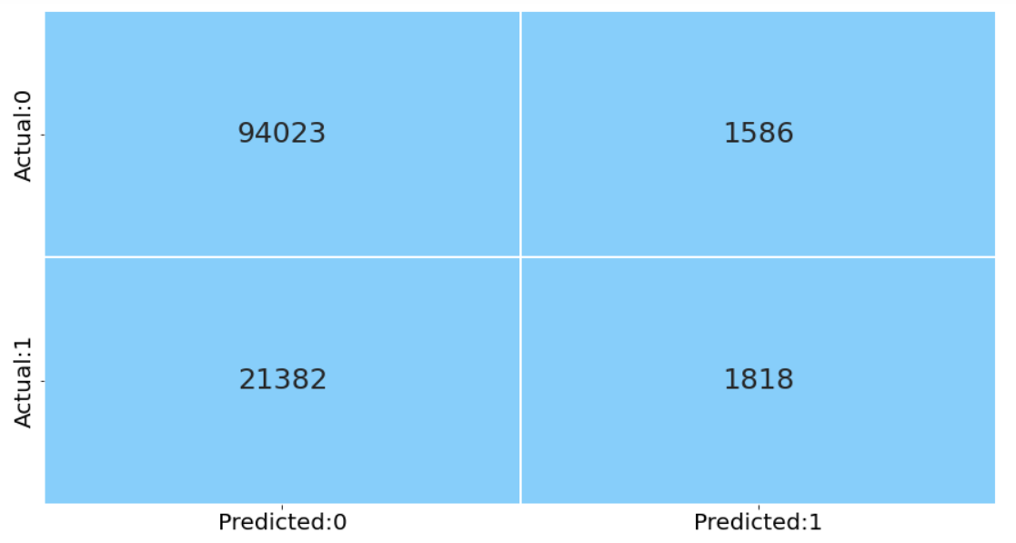
XGboost with RFE (features only)

Slide 31
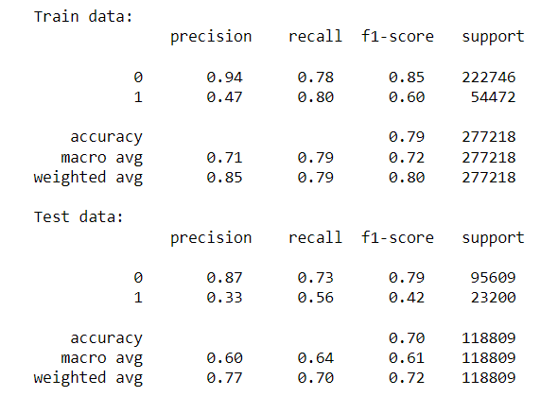
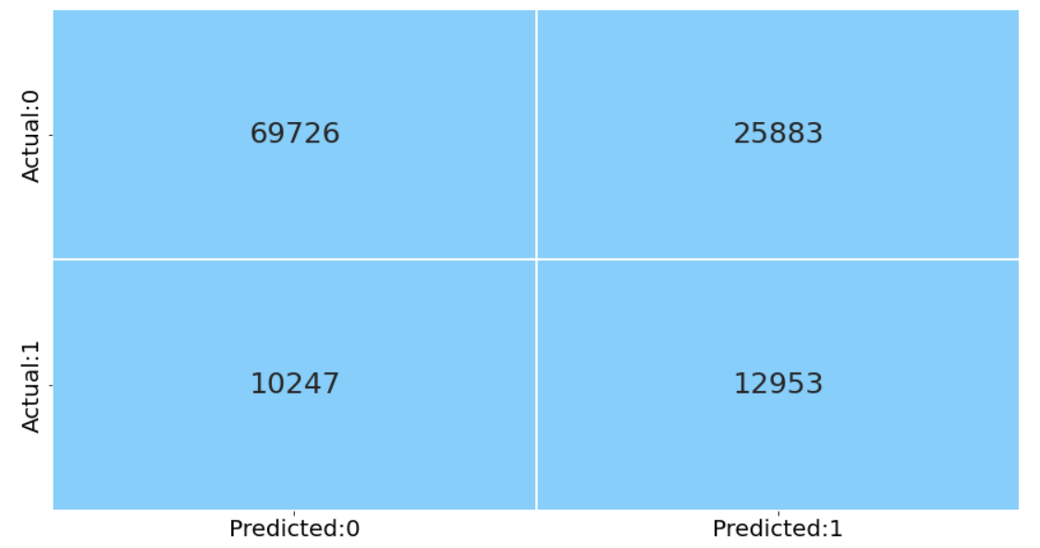
XGboost with RFE (features only) Oversampling Model
Inference:
According to XGBoost model report, we can observe that train-test values are good.
Compared to previous models XGBoost model, the errors have been reduced.
Comparatively the recall value has been boosted from 7% to 56%
Compare to base Decision model, the overfitting is reduced and FN errors are reduced by
nearly 50%

Slide 32
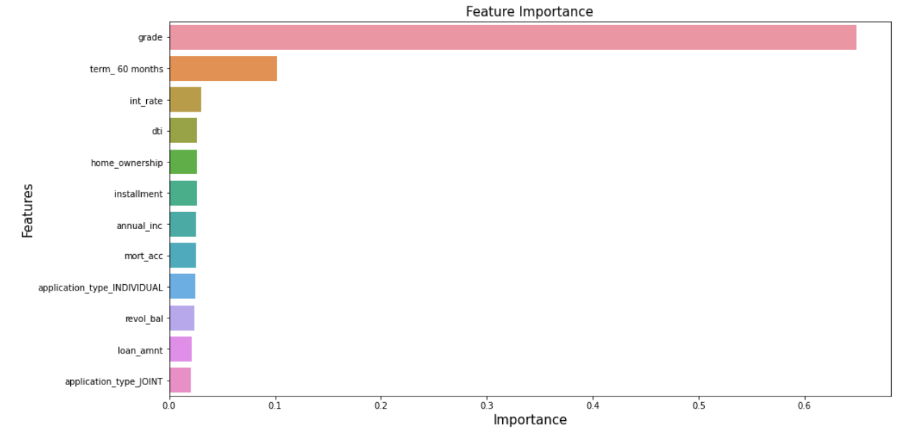
Features Importance

Slide 33
Score Card Algorithms

Slide 34
Business Insights:
XG Boost model is performing well in predicting defaulters based on the Historical Data. Company can deploy this model for the prediction to check which borrower can be possible defaulters in future and they will be able to reduce the number of defaulters and from that they will be able to reduce losses.
Company can also work on some of the weak areas which we have analysed during EDA analysis like from 2007 to 2009 the fully paid and defaulters were balanced but as the number of public record bankruptcies increases the defaulters also increased

Slide 35
Thanks!

